Slide 1
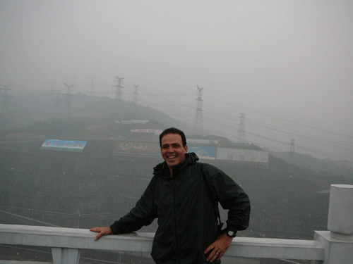
Yangtze River and
Three Gorges Dam
Sources: http://www.pbs.org/itvs/greatwall/controversy.html

Slide 2
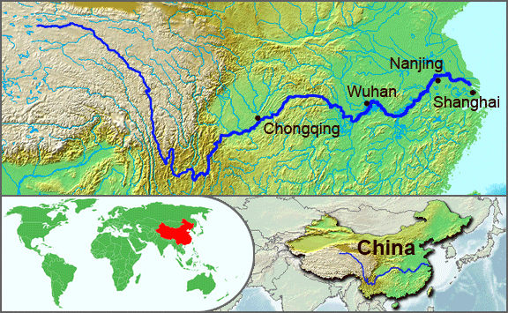
Yangtze River
longest river in Asia and third longest in the world (6100 km).

Slide 3
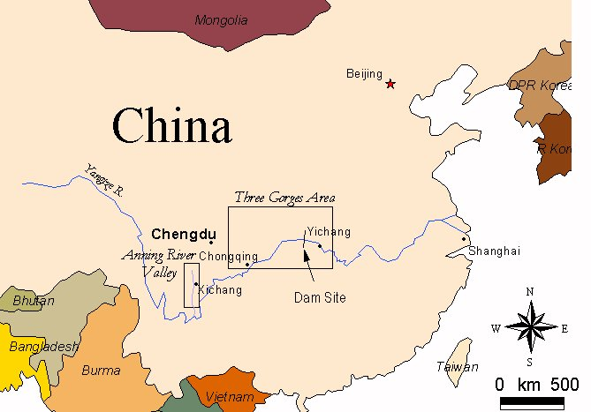
Three Gorges Dam

Slide 4
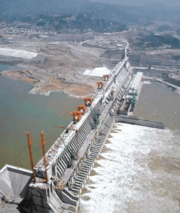
Three Gorges Dam
Dam consists of a 610-foot high wall running 1.3 miles from bank to bank.
World's Largest Hydropower Plant, producing 10% of China’s overall power needs.
Power generation capacity of Three Gorges equivalent to 15 nuclear power plants.
Project is estimated to be completed in 2009 at a cost of over $30 billion.

Slide 5
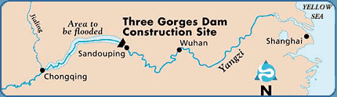
World’s Largest Reservoir
Reservoir created by the dam will form the world's largest
water storage reservoir, extending 360 miles up river to
Chongqing, a distance equal to nearly half the length of the
state of California.

Slide 6
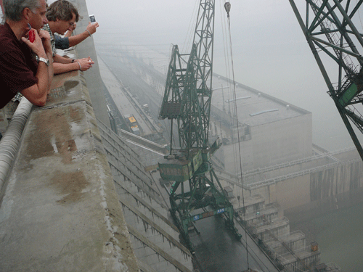
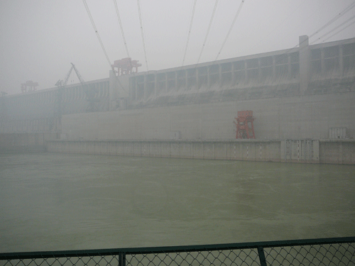
Views of the dam

Slide 7
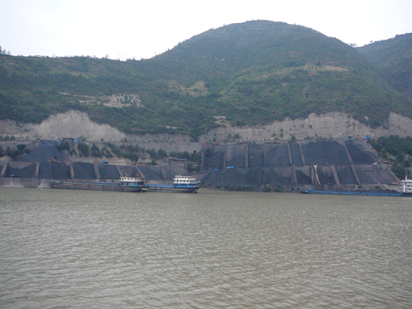
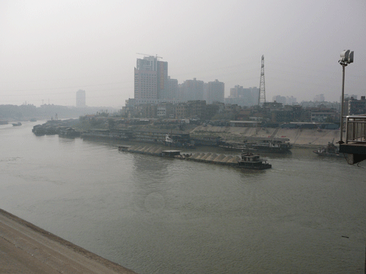
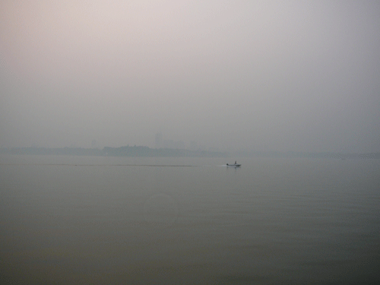
Positive aspects
Hydropower is clean, renewable energy, important for a country that is overly dependent on coal.

Slide 8
Reduced flooding
In the past 2,000 years, the Yangtze River has experienced 215 catastrophic floods.
In 1998, flooding in the area expected to be controlled by the dam resulted in 4,000 dead, 14 million left homeless and $24 billion in economic loss.

Slide 9
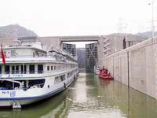
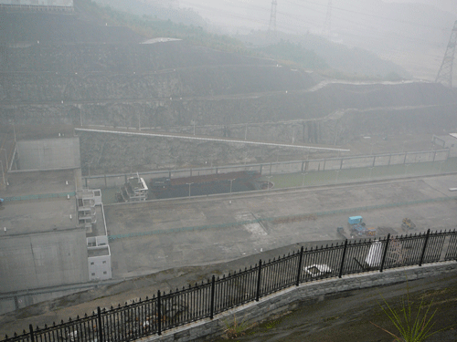
Navigation
Dam includes huge step locks and an elevator to allow passage of ships.
Locks bi-directional; can take 4 hours to pass (free-of charge).
Elevator only takes 40 minutes; won’t be on line until 2008; upstream only; fee charged.
Only cargo we saw was coal.

Slide 10
Negative aspects
When the dam is completed, 13 cities, 140 towns, over 1,300 villages, 599 industrial and mining enterprises, and 31,000 hectares of farmland will be submerged by the reservoir.
Unprecedented resettlement effort, affecting 0.8 -1.2 million people.
Cost of ~$15 billion USD for relocation and rebuilding infrastructure.

Slide 11
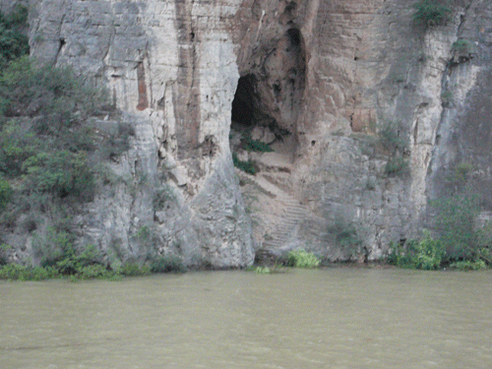
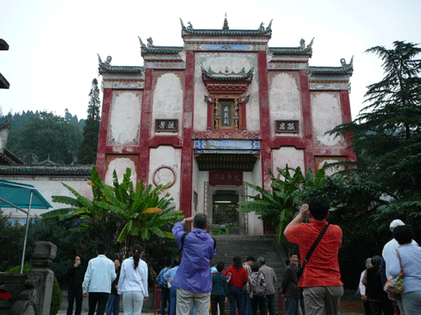
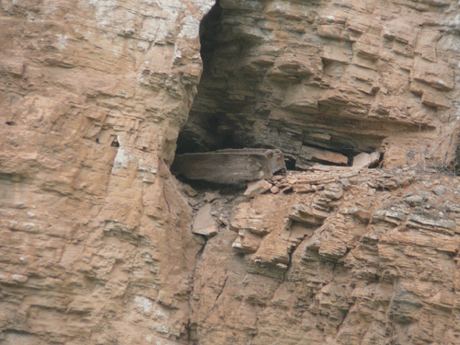
Negative aspects cont’d
1,300 known antiquities and archeological sites will be lost forever under water; ancient temples relocated.

Slide 12
Negative aspects cont’d
Over 265 billion gallons of raw sewage are dumped into the Yangtze annually. Currently the river flushes this downstream and out into the ocean.
Upon completion of the Three Gorges project, the sewage will back up in the reservoir.

Slide 13
Negative aspects cont’d
Over 1,600 factories and abandoned mines will be submerged when the dam is completed. Environmentalists predict that toxins associated with industry and mining will create a hazard for the animals and people who depend on the river for survival.

Slide 14
Negative aspects cont’d
Over 700 million tons of sediment are deposited into the Yangtze annually, making it the fourth largest sediment carrier in the world. Experts believe that this sediment will build up behind the dam, with only an unproven system of sluice gates to release it.

Slide 15


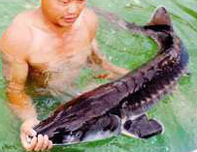

Endangered biota
The Three Gorges Dam project
threatens many endangered
species that are native to the
Yangtze River.
The baiji dolphin, the ancient river sturgeon and the finless porpoise depend on the Yangtze for their survival. Migration prevented by the dam.
The population of Siberian cranes in Poyang Lake will also be affected by the dam.
Rare indigenous plants being relocated to higher elevation save them from extinction

Slide 16
Information sources
Hank Bart’s 2006 China travel log
Yangtze River map: (http://yangtzeriver.quickseek.com/)
The Great Wall Across the Yangtze (http://www.pbs.org/itvs/greatwall/).
Finless dolphin image (http://www.cms.int/reports/small_cetaceans/data/N_phocaenoides/n_phocaenoides.htm
Chinese sturgeon image (http://www.chinaculture.org/img/2003-09/24/afish04_01.jpg)

